Slide 1
Photospheric emission from GRB jets
Hirotaka Ito RIKEN
Collaborators
Shigehiro Nagataki (RIKEN), Jin Matsumoto (RIKEN),
Shiu-Hang Lee (JAXA), Masaomi Ono (Kyushu Univ.),
Jirong Mao (Kyushu Univ), Asaf Pe’er (UCC), Akira Mizuta (RIKEN),
Alexei Tolstov (IPMU), Maria Dainotti (RIKEN), Maxim Barkov (RIKEN)
Shoichi Yamada (Waseda Univ.), Seiji Harikae (Mitubishi UFJ)
＠ GRB workshop 2015 /3/3

Slide 2
Plan of this talk
Introduction
・Brief overview of prompt emission of GRBs
・Photospheric emission model
Photospheric emission from structured jet
・Spetrum and polarization
・Photospheric emission based on 3D jet simulation Ito+2015 in prep.
Summary
Ito + 2013, 2014

Slide 3
Model for Emission Mechanism
Internal Shock Model
flaw
・Low efficiency for gamma-ray production
・Difficult to model hard spectrum in low energy band (α)
Photospheric Emission Model
Natural consequence of fireball model
(e.g., Rees & Meszaros 2005, Pe’er et al.2005, Thompson 2007)
・High radiation efficiency
・Clustering of peak energy ~ 1MeV
γ
γ
photosphere
Internal shock
External shock

Slide 4
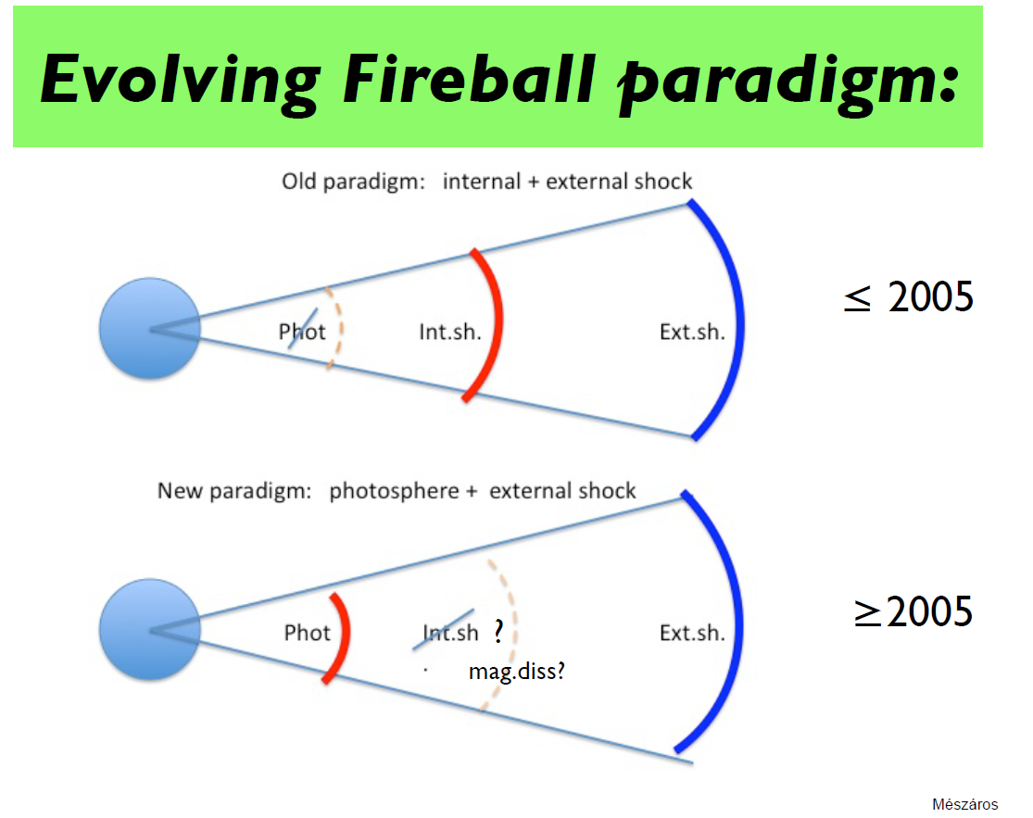
Slide from P.Meszaros @ SNGRB in Kyoto 2013

Slide 5
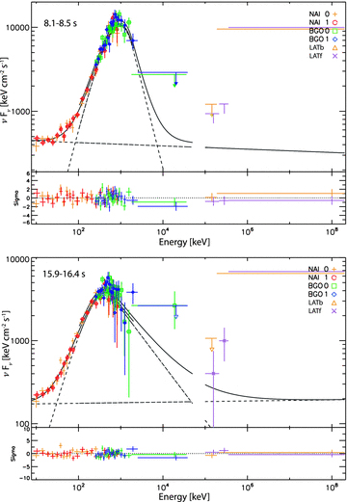
GRB 090902B
Strong evidence for the existence of photospheric emission
Slide from P.Meszaros @ SNGRB in Kyoto 2013
Ryde + 2011

Slide 6
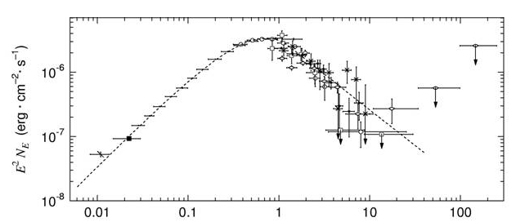
Difficulty in photospheric emission model
non-thermal spectrum
f_{ν}~ν^{-1.2}
f_{ν}~ν⁰
E (MeV)
Broadening from the thermal spectra is required

Slide 7
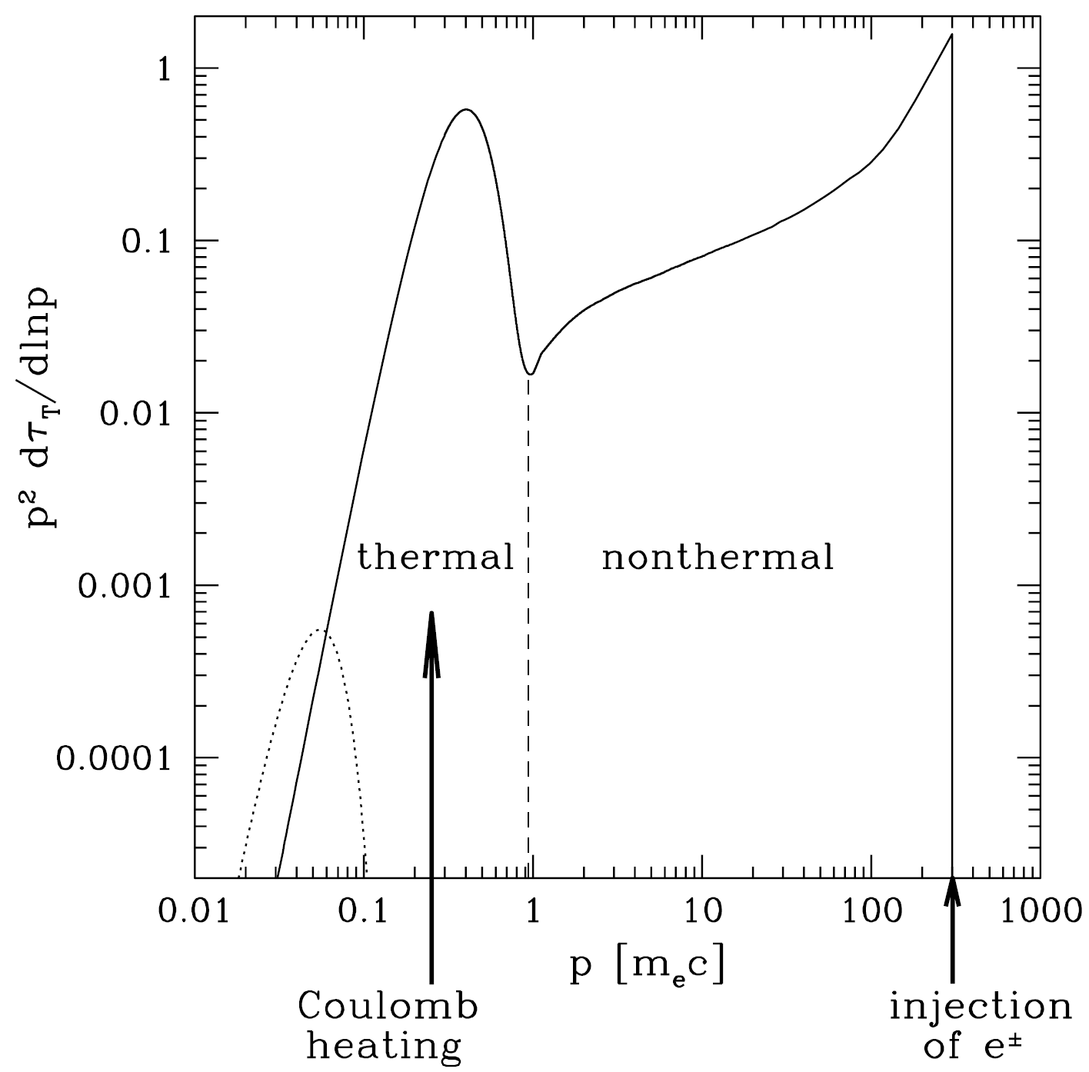
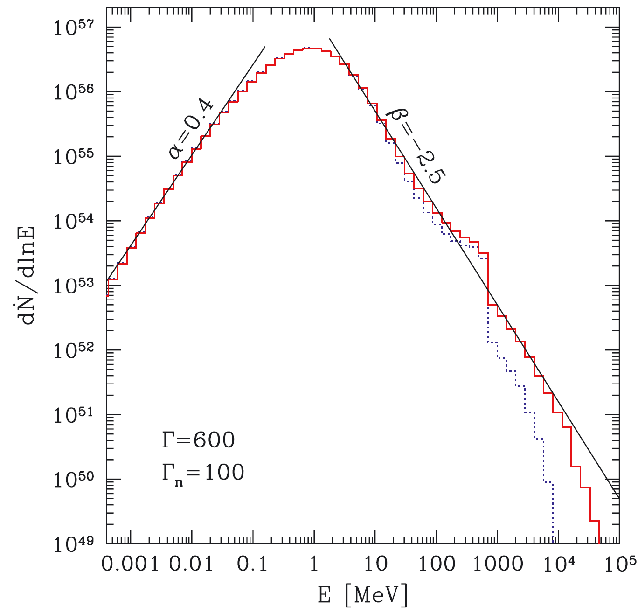
Dissipative process
high energy tail is reproduced by the relativistic pairs produced by dissipative processes
Magnetic recconection
assumption
Giannios & Spruit 2007, Giannios 2008, 2012
1D steady spherical outflow
Repeated Shock
Ioka + 2007, Lazzati & Begelman 2010
Proton-neutron collision
relativistic pairs upscatter thermal photons
Derishev 1999, Beloborodov 2010, Vurm+2011
Beloborodov 2010

Slide 8
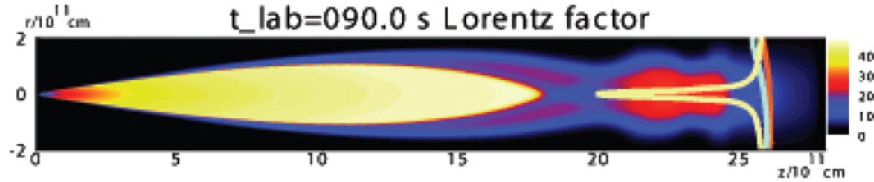
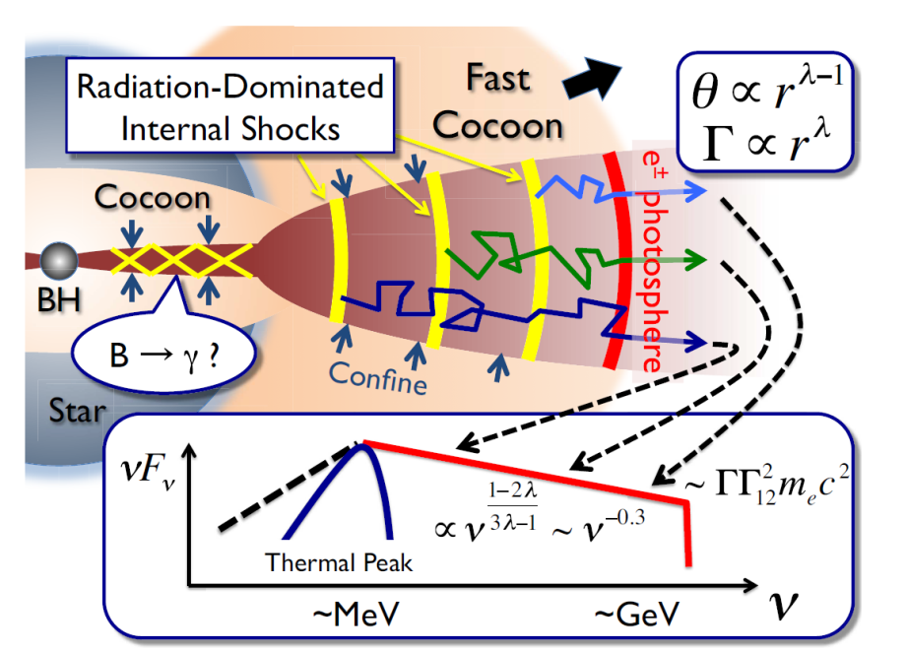
Geometrical brodening
Structure of the jet can give rise to the non-thermal spectra
Mizuta+2011
spectrum broadens even in the absence of relativistic pairs
Ioka+2011
Multi-dimensional structure of jet may be a key to resolve the difficulty

Slide 9
Our focus: Effect of the jet structure on the emission
Find the jet structure that can explain the observation
Stratified Jet structure
2 effects on the spectra
(I) multi-color effect
see also Lundman + 2013
Γ₁
Γ₀
Γ₁
τ~1
photosphere
νf_{ν}
Spine
Sheath
Γ₀ > Γ₁
ν

Slide 10
Our focus: Effect of the jet structure on the emission
Find the jet structure that can explain the observation
Stratified Jet structure
2 effects on the spectra
(I) multi-color effect
see also Lundman + 2013
(II) Fermi acceleration of
photons
Accleration region
Photons gain energy by crossing the boundary layer
τ~1
photosphere
νf_{ν}
Spine
Sheath
Γ₀ > Γ₁
ν

Slide 11
Our focus: Effect of the jet structure on the emission
Find the jet structure that can explain the observation
Stratified Jet structure
2 effects on the spectra
(I) multi-color effect
see also Lundman + 2013
(II) Fermi acceleration of
photons
Accleration region
Photons gain energy by crossing the boundary layer
τ~1
photosphere
νf_{ν}
Spine
Sheath
Γ₀ > Γ₁
ν
Propagation of photons are solved by Monte=Carlo method

Slide 12

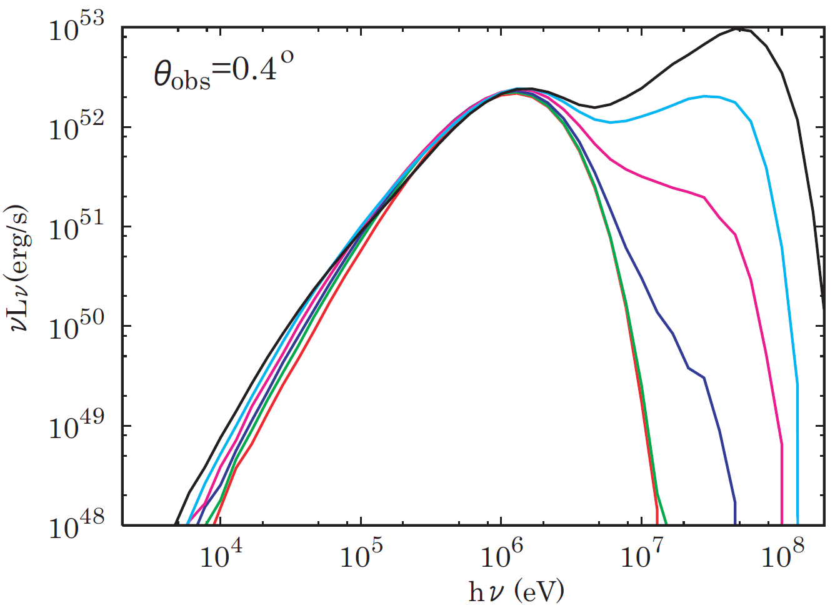
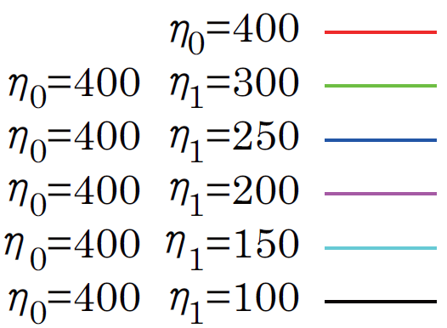

Two-component jet
Γ₀=400 θ_{j} =1° θ₀=0.5° θ_{obs}=0.4°
Thermal + non-thermal tail
Spine
Sheath
E_{max} = Γ₀m_{e}c²
Klein-Nishina cut-off
Non-thermal tail becomes prominent as the relative velocity becomes larger

Slide 13
Two-component jet
Γ₀=400 θ_{j} =1° θ₀=0.5° θ_{obs}=0.4°
Thermal + non-thermal tail
Spine
Sheath
E_{max} = Γ₀m_{e}c²
Klein-Nishina cut-off
Non-thermal tail becomes prominent as the relative velocity becomes larger
But limited only for narrow range of observer angle
|θ_{obs}- θ₀ | < Γ⁻¹ ～0.14°Γ₄₀₀⁻¹

Slide 14
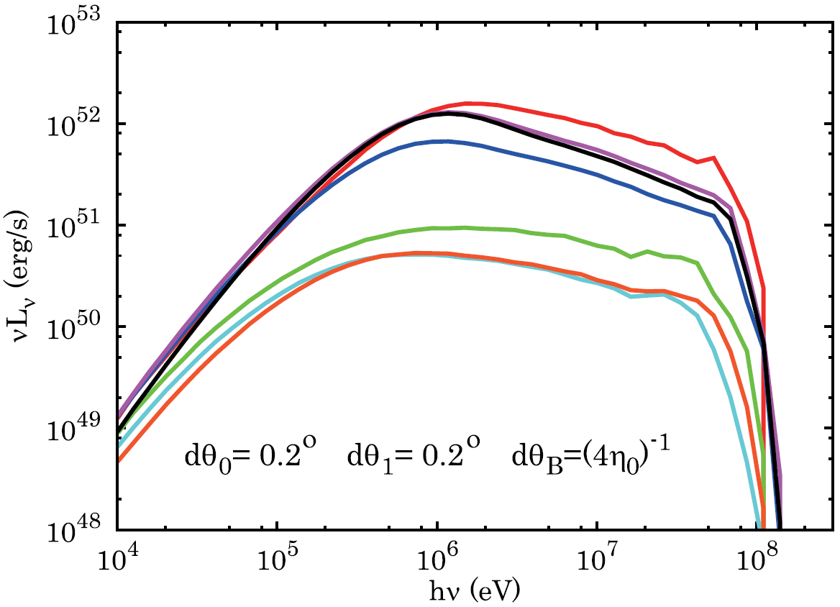

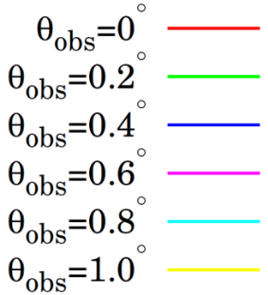

Multi-component jet
Γ₀=400 Γ₁=100
dθ
Interval of velocity shear dθ < 2Γ⁻¹

Slide 15
Multi-component jet
Γ₀=400 Γ₁=100
β= -2.5
dθ
E_{max} = Γ₀m_{e}c² ~ 100MeV
Interval of velocity shear dθ < 2Γ⁻¹
high energy spectra (β) is reproduced by accelerated photons
Cut off at ~ 100 MeV

Slide 16
Multi-component jet
Γ₀=400 Γ₁=100
β= -2.5
α=-1.5
α=-1
dθ
E_{max} = Γ₀m_{e}c² ~ 100MeV
Interval of velocity shear dθ < 2Γ⁻¹
high energy spectra (β) is reproduced by accelerated photons
Cut off at ~ 100 MeV
Low energy spectra (α) is reproduced by multi-color effect see also Lundman + 2013

Slide 17
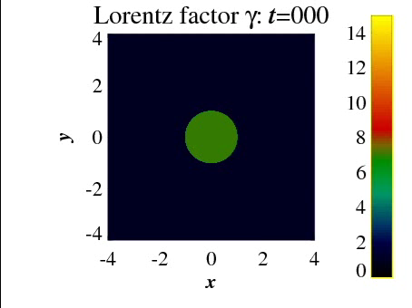

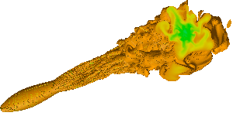
Multi-component jet
Γ₀=400 Γ₁=100
dθ
Face on view of jet
Simulation by Dr. Matsumoto
transverse structure

Slide 18
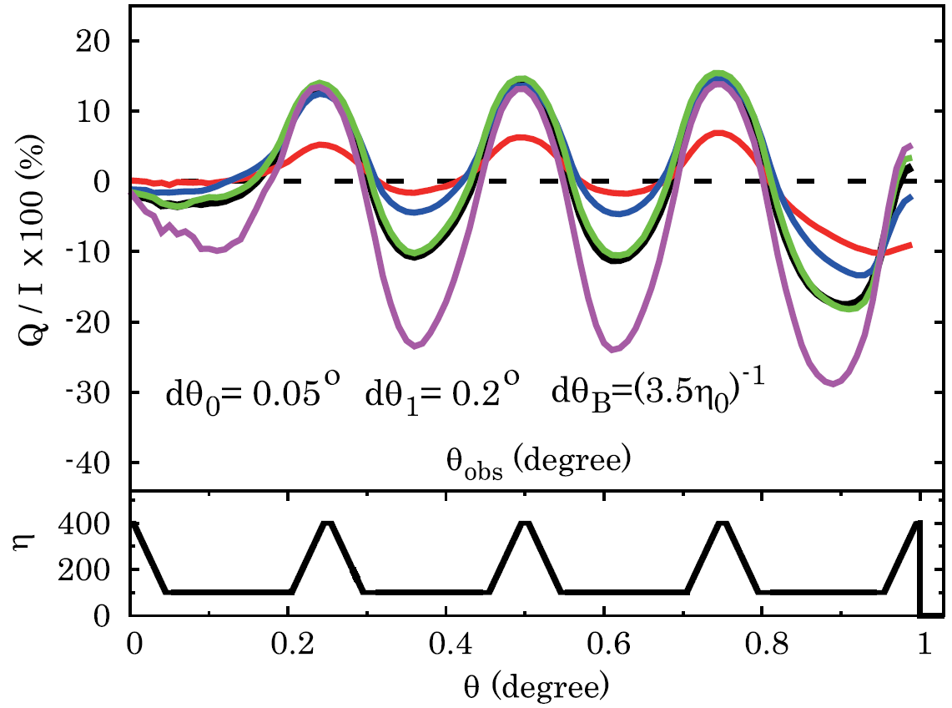
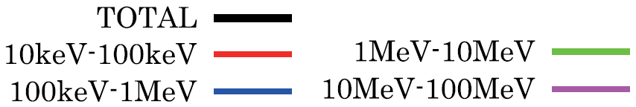
polarization
multi-component jet that reproduces Band spectra
Γ₀=400 Γ₁=100
DOP（％）＝(I₊ - I₋) / (I₊ + I₋)
0%
dθ
θ_{obs} (degree)
High polarization degree (>10%) is predicted
See also Lundman + 2014
Future missions such as Tsubame and POLAR may probe such an emission

Slide 19
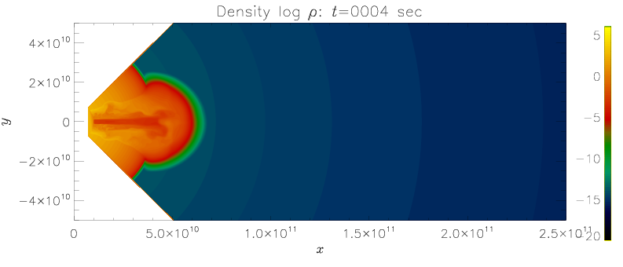
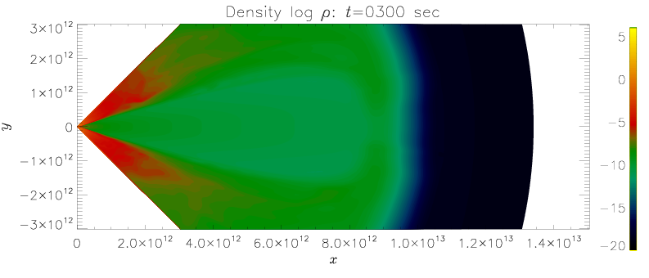
3D relativisitic hydrodymaical simulation
Calculation of relativistic jet breaking out of massive progenitor star
Progenitor star
t=4s
16TI （Woosley & Heger 2006）
M* ~14Msun
R* ~ 4×10¹⁰ cm
@presupernova phase
Jet parameter
L_{j} = 10⁵⁰ erg/s
t=300s
θ_{j} = 5°
Γ_{j} = 5
Γｈ = 500
Ｒ_{inj} = 10¹⁰ cm
Model 1: steady injection
Model 2: precession
Notes:
流体計算の設定（親星、ジェットパラメター）

Slide 20
3D relativisitic hydrodymaical simulation
Calculation of relativistic jet breaking out of massive progenitor star
Progenitor star
t=4s
16TI （Woosley & Heger 2006）
γ
M* ~14Msun
R* ~ 4×10¹⁰ cm
@presupernova phase
γ
Jet parameter
L_{j} = 10⁵⁰ erg/s
τ_{inj} >> 1
τ= 1
t=300s
θ_{j} = 5°
Γ_{j} = 5
γ
Γｈ = 500
γ
Ｒ_{inj} = 10¹⁰ cm
Model 1: steady injection
Model 2: precession
Radiative transfer calculation
Propagation of photons are calculated until they reach optically thin region
Notes:
流体計算の設定（親星、ジェットパラメター）

Slide 21
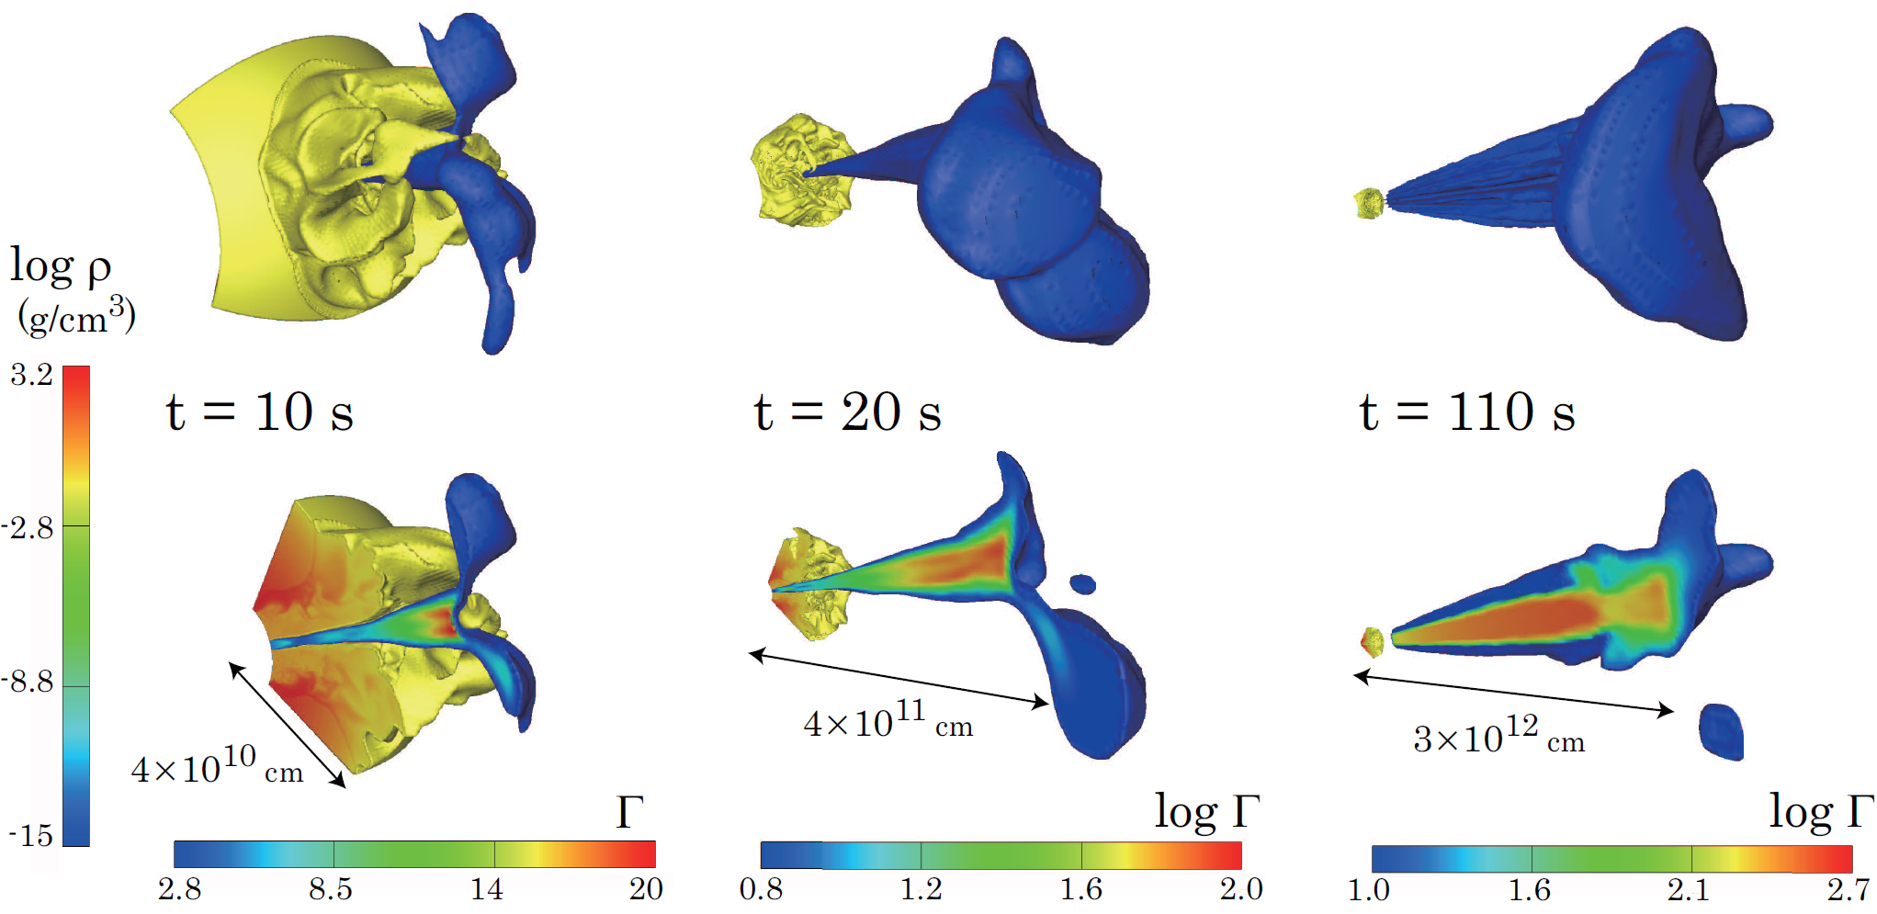
Model 1 steady injection
log Γ

Slide 22
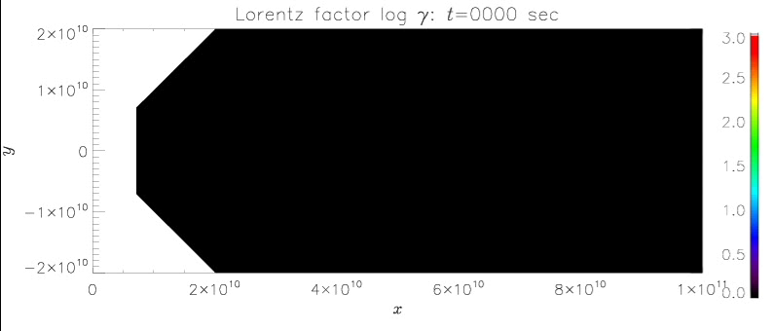
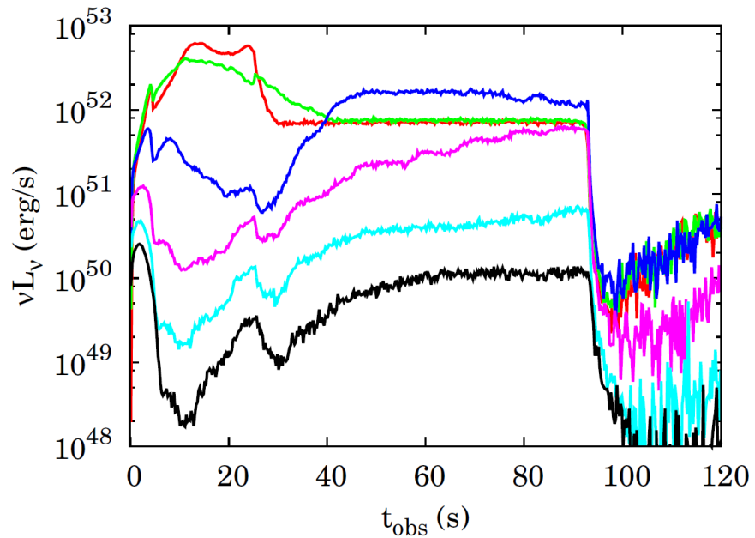
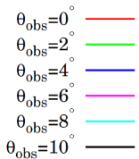
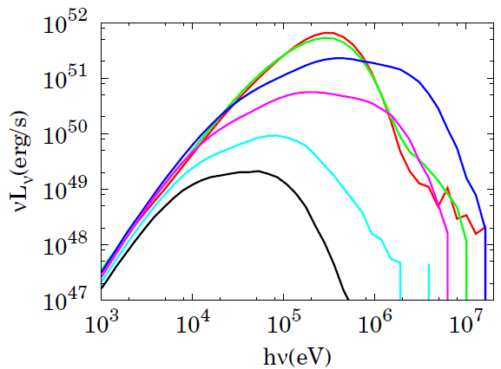
Model 1 steady injection
log Γ

Slide 23
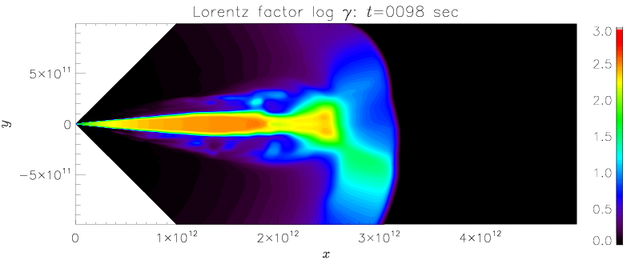
Model 1 steady injection
log Γ
４°
Photons are accelerated at the shock
β＝-2.5
α＝-1
However
Numerical diffusion smears out the sharp shock structure
Efficiency of acceleration is artificially decreased

Slide 24
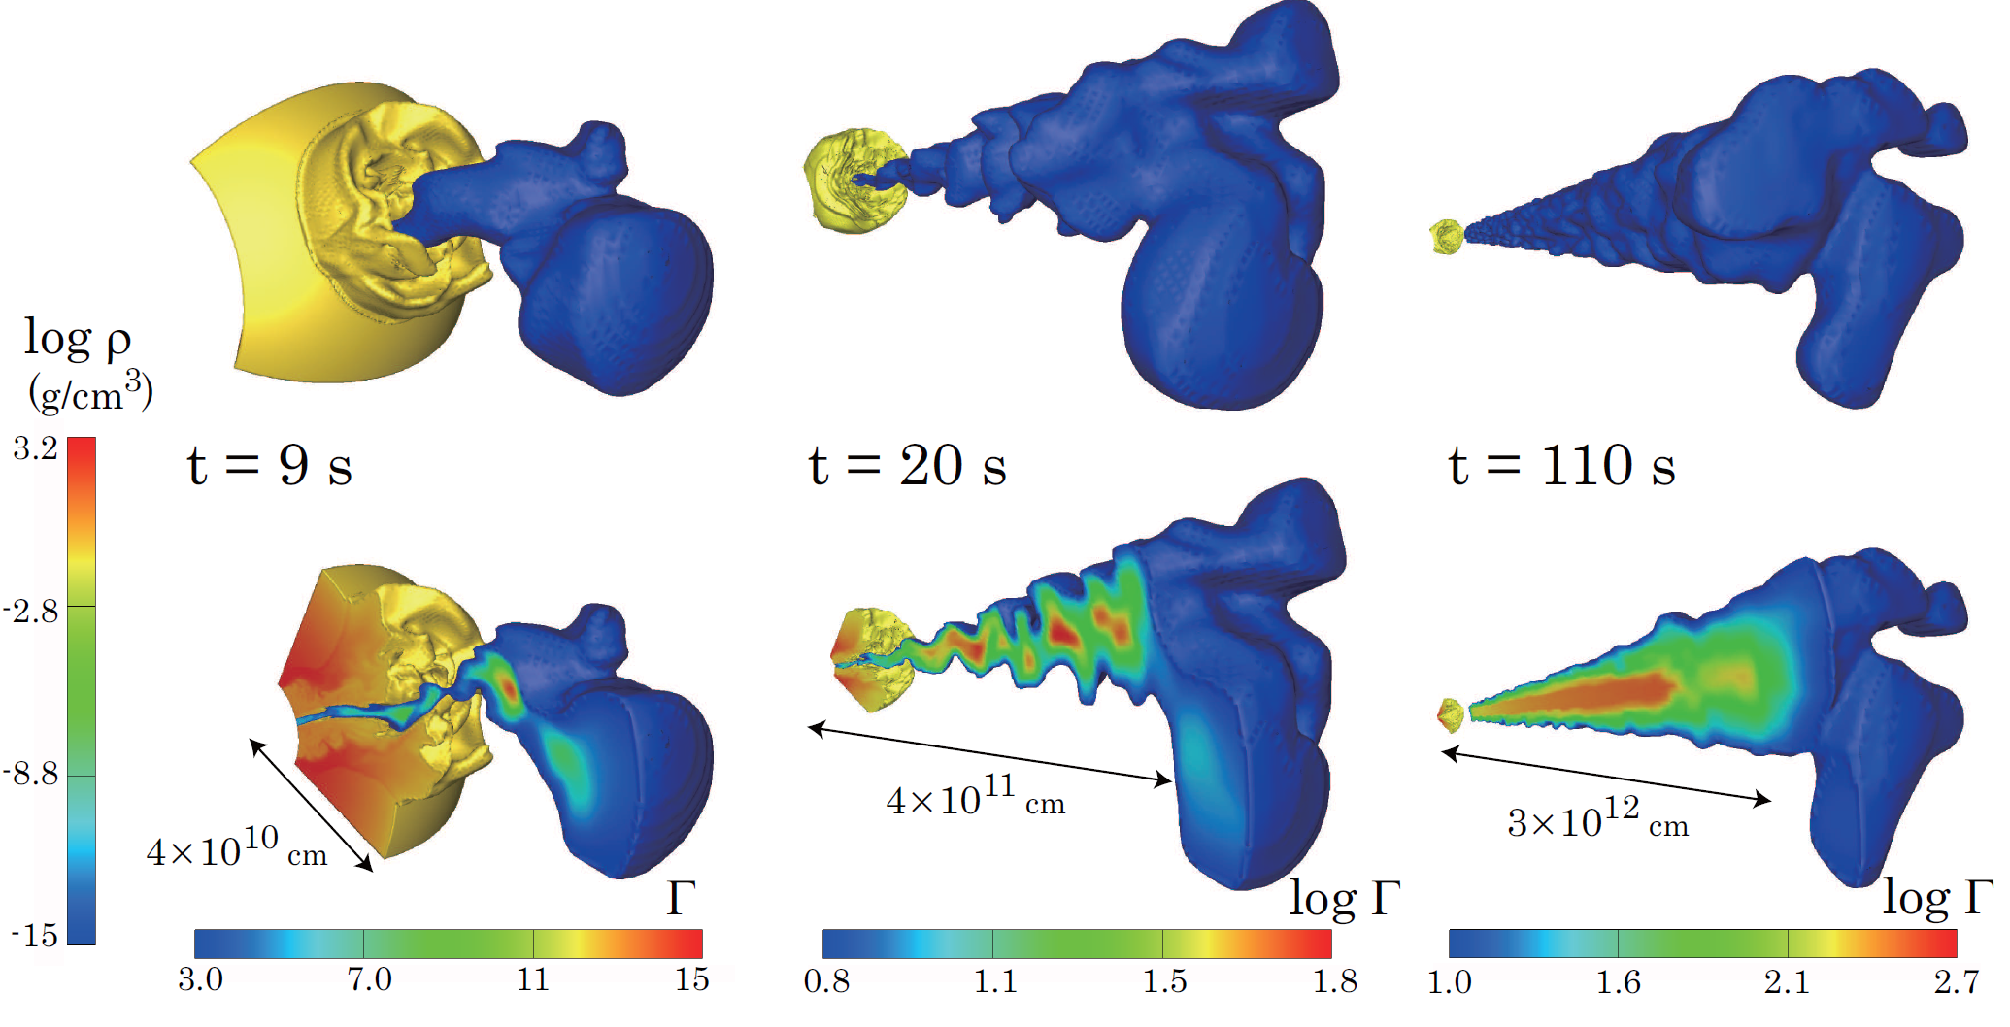
Model 2 Precession (t_{pre}=2s θ_{pre} = 3°)
log Γ

Slide 25
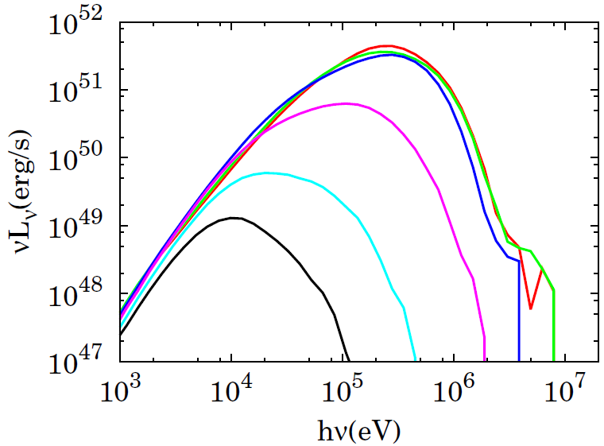
Model 2 Precession (t_{pre}=2s θ_{pre} = 3°)
log Γ
Precession activity can be directly observed in the lightcurve

Slide 26
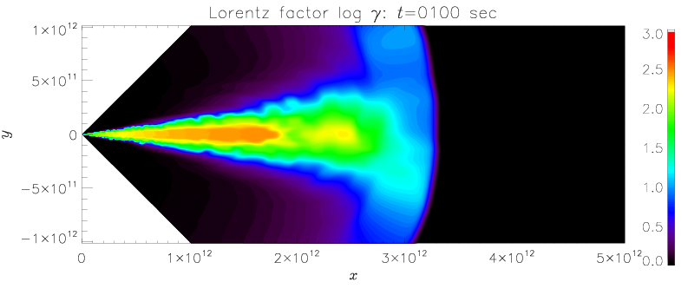
Model 2 Precession (t_{pre}=2s θ_{pre} = 3°)
log Γ
β＝-2.5
Precession activity can be directly observed in the lightcurve
α＝-1

Slide 27
Summary
-
Structured jet can produce a broad non-thermal spectrum
non-thermal particle is not required
-
such structure can naturally develop during propagation
Multi-component jet can reproduce Band function irrespective to the observer angle
β is reproduced by the accelerated photons
α is reproduced by the multi-color effect
-
Polarization signature is not negligible in the structured jet
High DOP (>10%) is predicted for the jet structure that reproduces Band function
-
Central engine activity can be directly observed in the light curve
engine activity is not smeared out during the propagation
Futrure works
Photon accelerations in various structures with high spacial resolution calculation
shocks, turbulence

